Slide 1
Missing Value Imputation in Tabular Data Lakes
Overlap discovery
Overlap size estimation
Feng Luo, Hai Lan, Hui Luo, Zhifeng Bao, J. Shane Culpepper, Shazia Sadiq, Xiaoli Wang. Missing value imputation in tabular data lakes unleashed: A hybrid approach. VLDBJ 2026.
Notes:
We use this work to illustrate how we identify relevant datasets for a given table and leverage them to impute missing values.

Slide 2
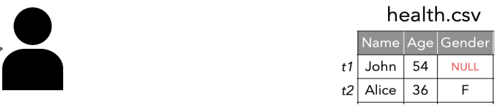


Missing Value Imputation in Tabular Data Lakes
Why
Incomplete data within individual tables
Avg. 38% of missing values
I want to know the gender for John with 54 years old in the table “health.csv”.
Null
I want an imputed value instead of the Null value.

Slide 3
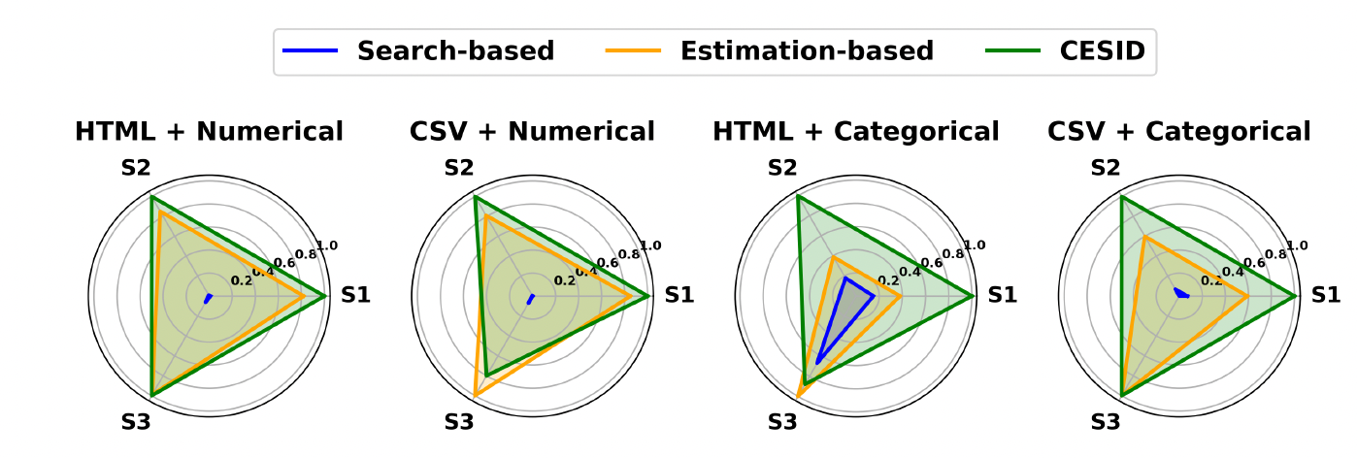
Missing Value Imputation in Tabular Data Lakes
Why
The gap in existing imputation work
Our CESID combines estimation-based and search-based methods to jointly handle all aspects of variety.
Table types
(HTML, CSV)
Data types of missing value (Numerical, Categorical)
Source of imputed value
(S1-S3)
S1: Same values from tables in the data lake
S2: Similar values in other data lake tables
S3: Similar values in the same table
Fail to handle all three aspects of variety

Slide 4
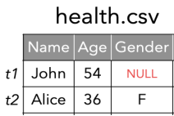
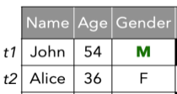

Missing Value Imputation in Tabular Data Lakes
Goal
Input
Output
Incomplete Table
Imputed Table
Objective
Tabular Data Lake
Effectively provide a replacement value for every missing value using values from the tabular data lake

Slide 5
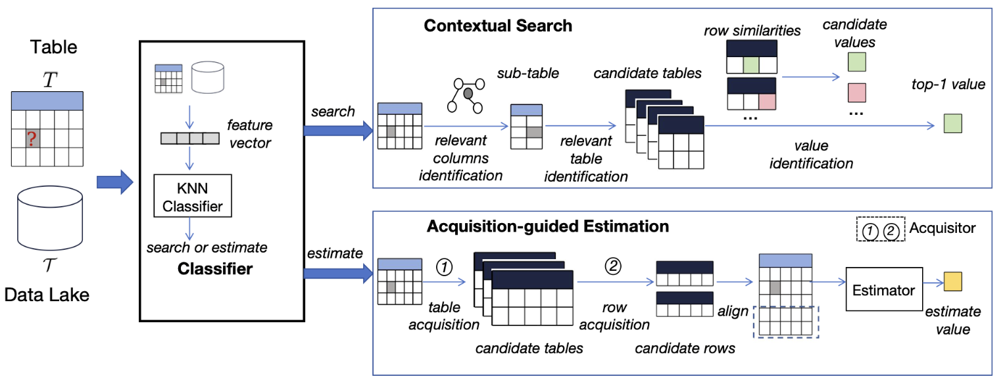
Missing Value Imputation in Tabular Data Lakes
How
Challenge
Effectively combine the strengths of search-based and estimation-based approaches for imputation
Our Approach
1. Contextual Search: identify candidate values from tables by exploiting the contextual information
2. Acquisition-guided Estimation: produce estimated values via the influence function and a sampling strategy
3. Classifier: determine the most appropriate value based on table-level and column-level features

Slide 6
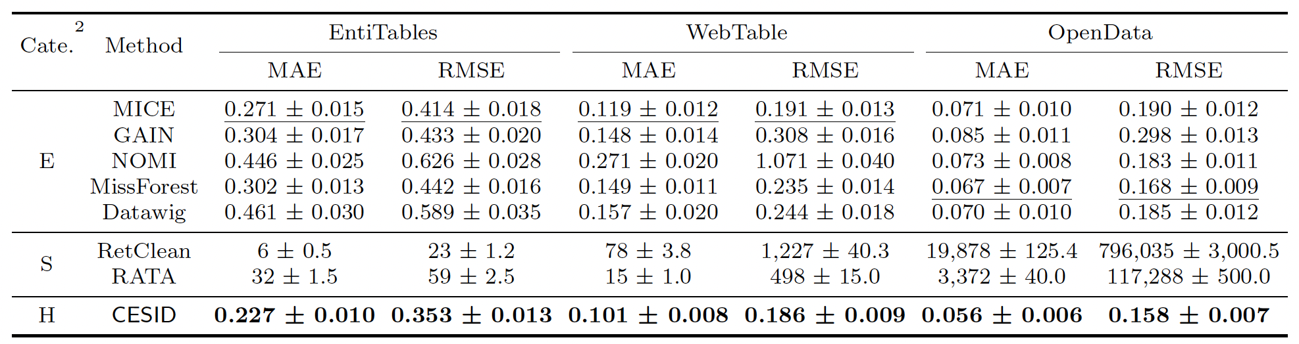
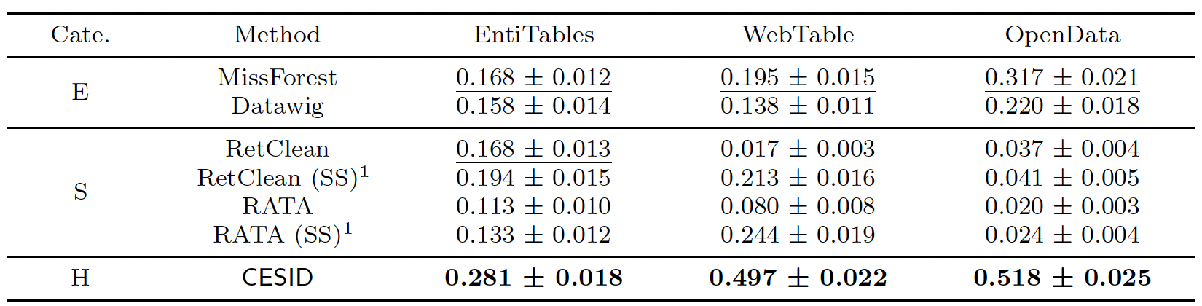
Missing Value Imputation in Tabular Data Lakes
Exp
Imputation error for numerical values
Our method CESID reduces imputation error by 16% on average.
Imputation accuracy on categorical values
Our method CESID improves imputation accuracy by an average of 95%.

Slide 7
Missing Value Imputation in Tabular Data Lakes
Summary
Contribution
We propose CESID, a hybrid method that uses a Combination of Estimation-based and Search-based methods for missing value Imputation in Data lake.

